Slide 1
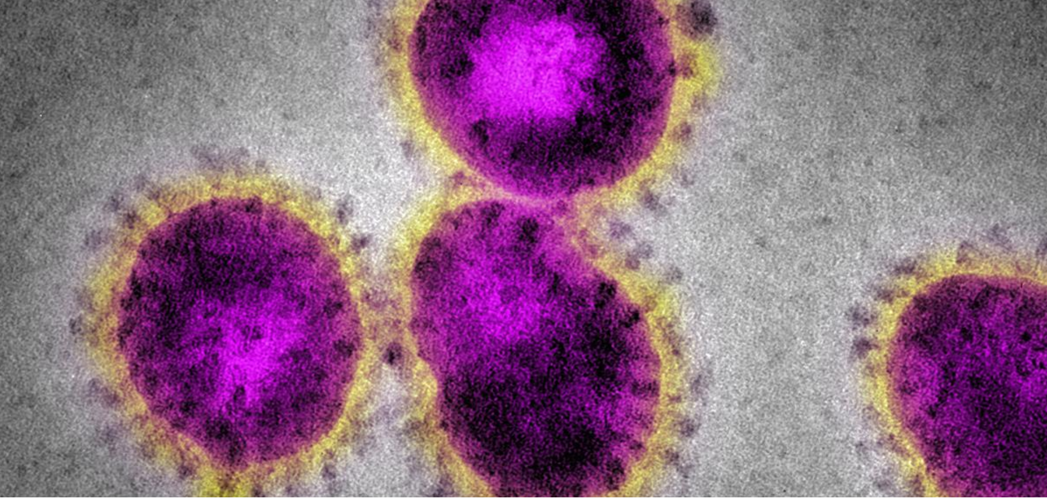
Coronavirus
(COVID-19)
Update

Slide 2
COVID-19: the key facts
Origin: Wuhan China, November 2019
Incubation period: 1-27 days
No vaccine, no treatment
Mortality: 2.3-3.4%
SARS: 10%
Influenza: 0.1%
Virus in US for >6 weeks

Slide 3
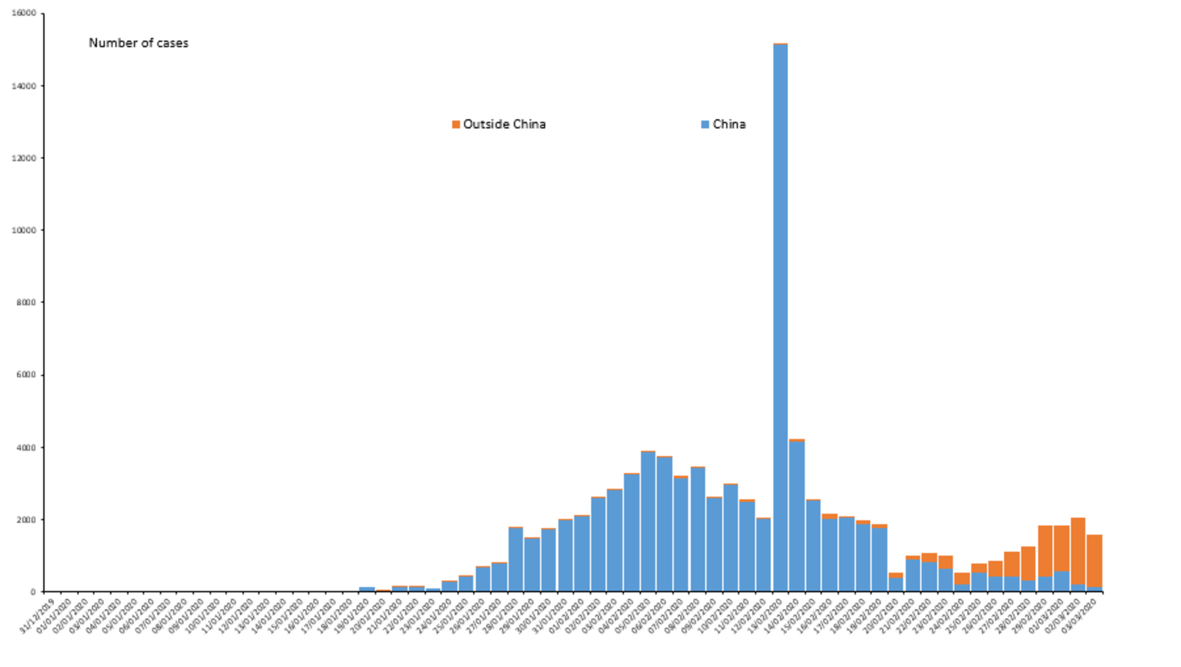

Slide 4
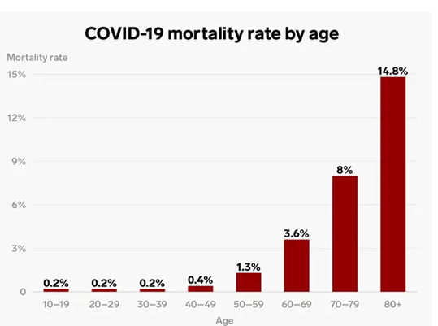

Slide 5
Wong et al. Radiology CT Imaging. In press.

Slide 6
Ng et al. Radiology CT Imaging. In press.

Slide 7
Fang et al. Radiology. In press.

Slide 8
CT findings of COVID-19
Early
Nonspecific findings
Mild patchy bilateral ground glass opacity and consolidation
High suspicion of COVID-19 in these cases mainly due to high pre-test probability in high risk patient (travel to high-risk area or COVID-19 contact)
Late
More specific, resembles organizing pneumonia
Focal, patchy bilateral rounded areas of ground glass and consolidation
May have reversed halo (atoll) sign or perilobular opacities
Most severe cases
Much less specific than above
Diffuse alveolar damage
Diffuse ground glass and consolidation

Slide 9
CT vs. PCR in detection of COVID-19: Fang et al. Radiology. In Press.
CT: 98% sensitive
PCR (initial): 71%

Slide 10
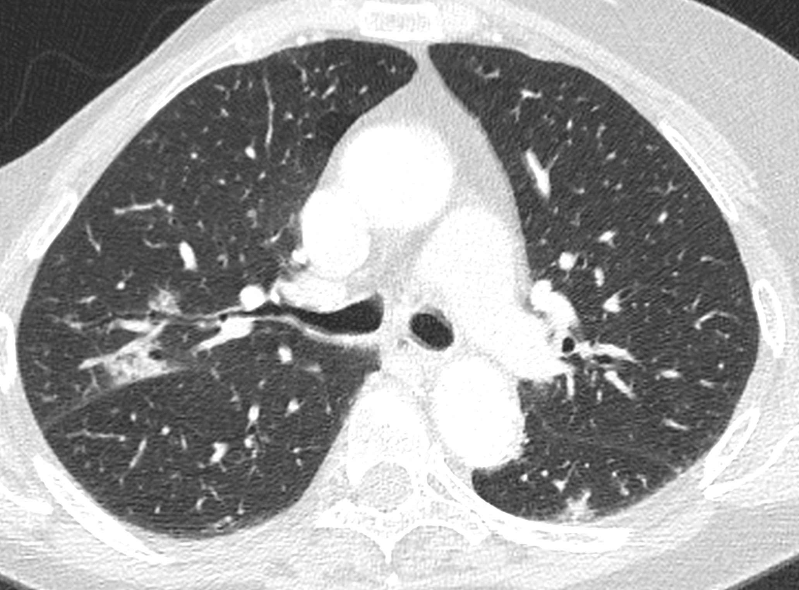
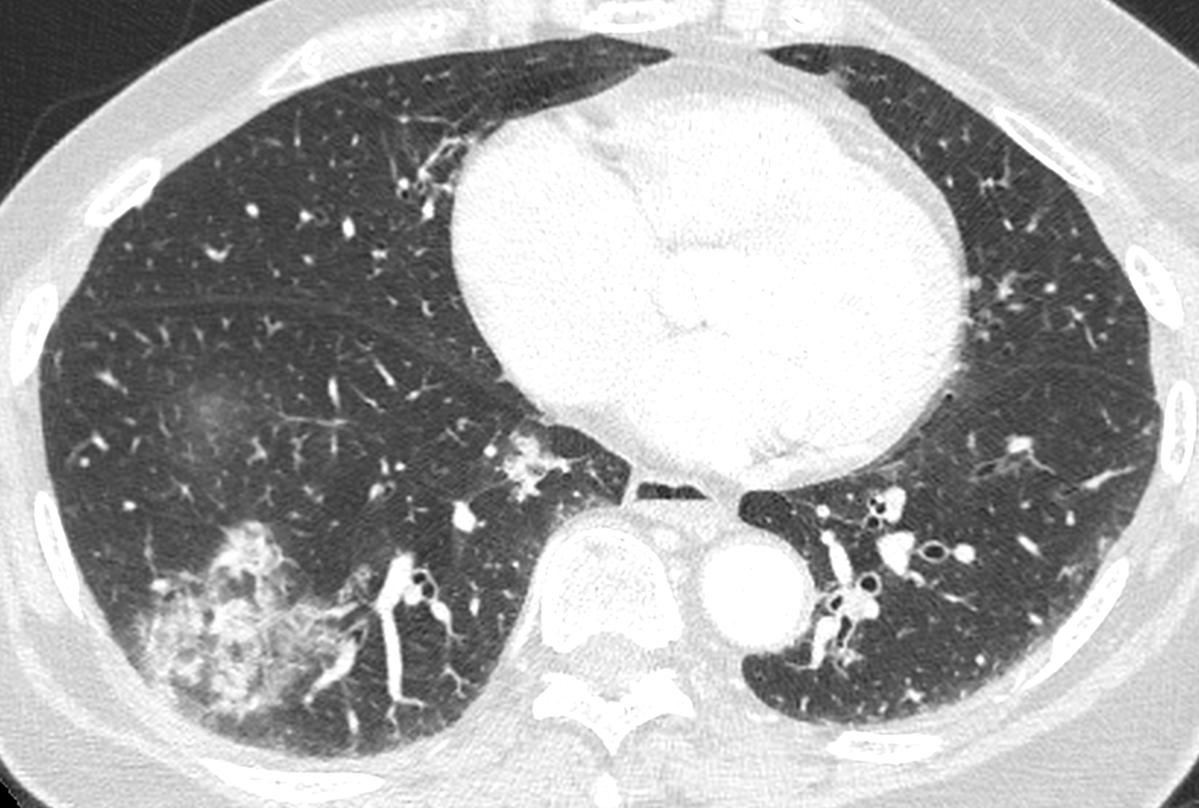
UCSF case with suggestive imaging findings
Note the rounded
opacity here:

